Slide 1
Financial Analysis Software
Honors Project 2024
Thomas O’Connor

Slide 2

What is ?
FAS is a program that processes financial data from companies to predict stock performance
Let’s explore how:

Slide 3

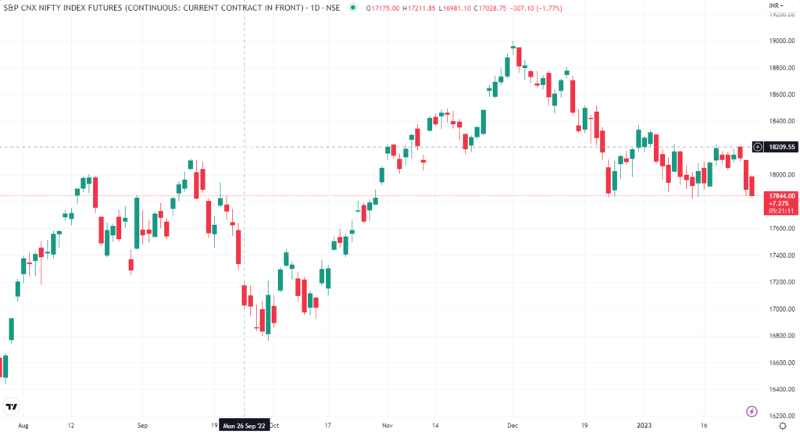
AAPL
Stock Price

Slide 4

SEC Filings
AAPL
10-K
10-Q
10-Q
10-Q
10-Q

Slide 5




Reported Financials
The problem with
Assets
Cost of Goods Sold
Other Financials in USD:
Net Income
Liabilities
Operating Expenses
Operating Assets
Operating Liabilities
And many more
SEC Filings
$1,000,000
$1,000
Stock Price
Stockholder’s Equity
Sales
+5%
Sales
+50%
Explicit financials are uncorrelated with stock performance.
We need to normalize them!
Notes:
Reported financial figures only convey the size of the company, not how well they’re performing on the market

Slide 6
Financial Ratios
AMD 2015 10-K
Profit Margin | Asset Turnover | Return on Assets (ROA)
Net Income / Net Sales | Net Sales / Assets | Net Income / Assets
-558000000 / 3033000000 | 3033000000 / 2466000000 | -558000000 / 2466000000
-0.1839762611 | 1.2299270073 | -0.2262773723
Excerpts from the code:
Profit_Margin = net_income / net_sales
Asset_Turnover = net_sales / total_assets
ROA = net_income / total_assets
Profit Margin: The percentage of revenue that turns into profit after all expenses are deducted.
Asset Turnover: A ratio that measures how efficiently a company uses its assets to generate revenue.
Return on Assets (ROA): A metric that indicates how profitable a company is relative to its total assets, expressed as a percentage.
Assets: 2466000000
Net Income: -558000000
Net Sales: 3033000000
Financial Ratios serve to:
Convert explicit financials into a percentage relative to the company
Provide a meaningful perspective on how the company operates

Slide 7
Leveraging Ratios
Stock Price
FAS ratios
Return on Equity
Return on Assets
Profit Margin
Asset Turnover
Financial Leverage
Return on Net Operating Assets
Net Operating Profit Margin
Net Operating Asset Turnover
Theoretical function to fit
Features
Target
A(PM) * B(AT) * C(FL) * D(ROE) * E(ROA) * F(RNOA) * G(NOPM) * H(NOAT) = Percent_Growth
We are going to use a neural network!

Slide 8
Dataset Development
All companies filing with the SEC
All reported 10-K and 10-Q forms
Extract/calculate ratios + stock growth
Consolidate clean data into a csv file
Features
Target
Features
Target
Notes:
Neural networks (NNs) need to be trained with many examples.
It forms an internal model of how stocks behave given input features, and the model is only as accurate as the data it is provided with.
To increase the accuracy of the model, we want to provide a comprehensive history of all companies, all of their reported finances, and all of their stock performances

Slide 9
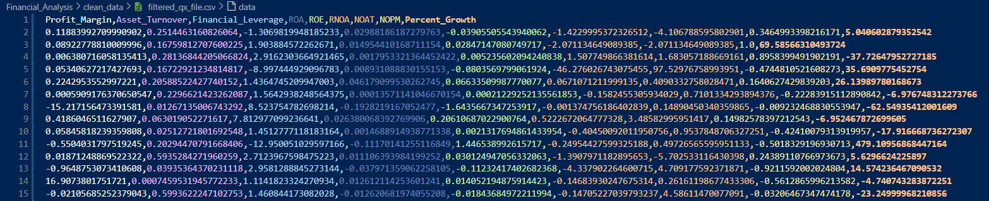
Dataset Development
A ‘history’ of company financial ratios and their respective stock performance after 1 year
The dataset is complete. Time to train the network.
Notes:
Neural networks (NNs) need to be trained with many examples.
It forms an internal model of how stocks behave given input features, and the model is only as accurate as the data it is provided with.
To increase the accuracy of the model, we want to provide a comprehensive history of all companies, all of their reported finances, and all of their stock performances

Slide 10
Dataset Development
5659 unique companies
Total:
~425,000 entries
~3,800,000 datapoints
Extract/calculate ratios + stock growth
Consolidate clean data into a csv file
All companies filing with the SEC
All reported 10-K and 10-Q forms
9 float datapoints per form
Up to 75 forms going back to 2009
Features
Target
Features
Target
Notes:
Neural networks (NNs) need to be trained with many examples.
It forms an internal model of how stocks behave given input features, and the model is only as accurate as the data it is provided with.
To increase the accuracy of the model, we want to provide a comprehensive history of all companies, all of their reported finances, and all of their stock performances

Slide 11
Neural Network Architecture
Sequential model (Feedforward network)
StandardScaler
Dense layers
Dropout layers
Classic NN visual

Slide 12
Performance
Finalize the model architecture and performance before completing this

Slide 13
Problems
Data only going back to 2009 (only bull markets no data for bear markets)
Bankrupt companies not represented (no api to fetch stock performance for delisted stocks)
SEC filings are irregular. Not every company has stockholder’s equity for example.
SEC filings can be manipulated. Assets defined as ‘probable future economic benefits obtained or controlled by an entity as a result of past transactions or events.’
Incorporating amended SEC filings.

